Slide 1

Explainable VLMs for E-commerce Indian Fashion Product Listing
by
Under guidance of
Harsh Vardhan Singh Chauhan
2022BCD0044
Dr. Jeena Thomas

Slide 2
Content
Introduction
Literature Survey
E-commerce Fashion Survey
Problem Statement
Objective
Proposed Architecture
Dataset
Sample Experiment
References

Slide 3
Introduction
Lack of Structured Annotation – Indian e-commerce space is flooded with millions of unstructured visual fashion images uploaded daily, lacking descriptive captions or hierarchical tags. This data makes it difficult to index, retrieve, and recommend items efficiently.
Diversity &Complexity of Indian Fashion - Generic captioning models trained on Western apparel datasets fail to capture this, leading to inaccurate or incomplete captions
Trust & Transparency – Explainability ensures users and stakeholders can trust AI predictions.
Challenges – Trade-off between accuracy and interpretability; scaling explainability to large models is difficult.

Slide 4
Literature Survey
Ref No | Method | Category | Dataset | Model | Task | Approach
1 | Grad CAM | Common Attribution | ImageNet, PASCAL VOC, COCO, VQA | VGG-16, ResNet, GoogleNet, AlexNet | Classification, Captioning, VQA | Gradient based activation mapping
2 | Integrated Gradients | Common Attribution | ImageNet | GoogleNet | Classification | Axiomatic attribution
3 | ViT Shapley | Common Attribution | ImageNette, MURA, Oxford IIIT-Pets | Vision Transformers | Classification | Shapley value estimation for feature importance
4 | LRP | Common Attribution | CIFAR-10, ImageNet, MIT Places | CNNs | Classification | Taylor expansion for feature attribution

Slide 5
Literature Survey
Ref No | Method | Category | Dataset | Model | Task | Approach
5 | Raw Attention | Attention based | Crop Satellite Data | LSTM-RNN, MS-ResNet, TempCNN | Classification, | Raw self-attention for time-series
6 | Attention Rollout & Flow | Attention based | Subject-verb agreement Dataset | BERT | Sentiment analysis | Graph-based quantification of attention flow in transformers
7 | Grad-SAM | Attention based | Stanford Sentiment Tree, AgNews, IMDB, MultiRC | BERT based models | Sentiment Analysis | Uses gradient with self-attention for activation maps
8 | Beyond Attention | Attention based | ImageNet, Movie Review, ERASER | BERT, Vision Transformer | NLP & Vision Tasks | Combines attention and propagation

Slide 6
Literature Survey
Ref No | Method | Category | Dataset | Model | Task | Approach
9 | Vision DiffMask | Pruning based | CIFAR-10, ImageNet | LSTM-RNN, MS-ResNet, TempCNN | Classification | Differentiable patch masking for hidden layer activations
10 | X-Pruner | Pruning based | CIFAR-10, ILSVRC-12 | BERT, Swin Transformer | Classification | Differentiable masks for unit contribution, layer-wise pruning
11 | EViT | Pruning based | ImageNet, JFT-300M | Transformers | Classification | Identifies and fuses inattentive tokens
12 | IA-Red2 | Pruning based | ImageNet, Kinetics-400 | Vision Transformers | Classification | Policy based dropout

Slide 7
Literature Survey
Ref No | Method | Category | Dataset | Model | Task | Approach
13 | ViT-CX | Inherently Explainable | ImageNette, MURA | Vision Transformers | Classification | Causal explanation using feature maps and clustering masks
14 | ViT-NeT | Inherently Explainable | CUB-200-2011, Stanford Cars, Stanford Dogs | Vision Transformers | Classification | Neural tree-based decoder
15 | R-Cut | Inherently Explainable | ImageNet, LRN | Vision Transformers | Classification | Relationship-weighted explanation and token cutting
16 | eX-ViT | Inherently Explainable | PASCAL VOC 2012, MS COCO 2014 | Vision Transformers | Weakly Supervised Segmentation | Explainable Multi-Head Attention & Attribute-guided Explainer

Slide 8
Literature Survey
Ref No | Method | Category | Dataset | Model | Task | Approach
17 | CLIP | Joint Embedding Space | MS-COCO, Visual Genome, YFCC100M, WIT (self-made) | Resnet, ViT, CBOW, Transformer | Contrastive training | Minimize cosine similarity between matching pairs of encoded image and text
18 | SHAP-CAT | Inherently Explainable | BCI, IHC4BC-ER, IHC4BC-PR | Resnet50, ViT, DenseNet | Cancer grading | Combining various discriminative task vector to SHAP
19 | Grounding DINO | Inherently Explainable | MSCOCO, LVIS, ODinW | Swin Transformer, Swin Transformer | Object Detection | Multiple cross attention between image and text. Decoder layer with self and cross attn.

Slide 9
Literature Survey
Ref No | Method | Category | Dataset | Model | Task | Approach
20 | ICEv2 | ViT Xai | ImageNet, ILSVRC, Pascal VOC | RobustViT, DeiT-S, DeiT-T | Segmentation | Adversarial Norm for separation of background
21 | 3VL | Gradient Based | MS-COCO, VL-CheckList, ImageNet | FLAN-T5, OpenAI Clip, ALIGN, VALSE, COLA | Image captioning | Contrastive loss for each layer of text tree. Patches of image matched with tokens. Token removal
22 | Segment Anything | Prompt based segmentation | SA-1B | SAM | Image segmentation | Prompt encoder combined with encoded image.

Slide 10
Literature Survey
Ref No | Method | Category | Dataset | Model | Task | Approach
23 | BLIP | VLM | COCO, Flickr30K | ViT Encoder, Bert Encoder, Blip Decoder | Image captioning, VQA, classification, Matching | Attends cross attention from image while generating text tokens
24 | PaliGemma 3b | VLM | ActivityNet, AI2D, OKVQA-DA, COCO, SciCap, ScienceQA etc | SigLIP 400M vision encoder, Gemma 2B text decoder, sentence piece tokenization | Captioning, VQA, segmentation, bounding boxes | Concatenating vision and text tokens; soft tokens for segmentation
25 | Qwen2 VL 4b | VLM | MMMLU, PolyMath, INCLUDE | SigLIP vision encoder, MoE text decoder | OCR, VQA, captioning | Mixture of Expert text decoder

Slide 11
E-commerce Fashion Survey
Ref No | Title | Abstract
26 | A Comprehensive Survey on Image Captioning for Indian Languages: Techniques, Datasets, and Challenges | Reviews image-captioning methods, datasets, challenges for Indian languages (Hindi, Bengali, Assamese) and highlights lack of annotated corpora.
27 | IndoFashion: Apparel Classification for Indian Ethnic Clothes | Introduces 106 K image dataset of Indian-ethnic clothes across 15 categories; notes Western datasets fail for Indian styles
28 | Attr2Style: A Transfer Learning Approach for Inferring Fashion Styles via Apparel Attributes | Proposes image-captioning via low-level attribute annotations to infer higher-level style captions under scarce labeled data.
29 | Fashion-Oriented Image Captioning with External Textual Memory | Proposes transformer with external memory retrieval to generate fine-grained fashion item descriptions from images.

Slide 12
E-commerce Fashion Survey
Ref No | Title | Abstract
30 | A Survey on Fashion Image Retrieval | Reviews fashion image retrieval datasets, annotations (attributes, landmarks) and reveals annotation scarcity in many real-world fashion domains.
31 | Leveraging AI and Computer Vision for Generating Precise E-Commerce Product Descriptions | Demonstrates CNN-LSTM approach to generate captions for ~9,000 product images but highlights limited scale for e-commerce domains.
32 | Let's Go Shopping (LGS) – Web-Scale Image-Text Dataset for Visual Concept Understanding | Releases 15 M image–caption pairs from e-commerce sites, showing general models struggle on e-commerce style image captioning

Slide 13
Problem Statement
Indian fashion datasets lack structured captions and domain-specific explainability mechanisms.
Existing explainability methods mainly target vision classification, neglecting multimodal captioning tasks.
No unified framework explains auto-regressive, Vision Language Models (ViT-based) in caption generation contexts.
Current models fail to align image regions with descriptive text, limiting interpretability in vision-language systems.

Slide 14
Objectives
Improve transparency and interpretability for Indian fashion e-commerce applications.
Develop an explainability framework for Vision-Language models based auto-regressive image captioning models.
Enable fine-grained visual–textual alignment to interpret how captions describe Indian fashion images.
Extend explainability beyond classification to multimodal reasoning in generative captioning.

Slide 15
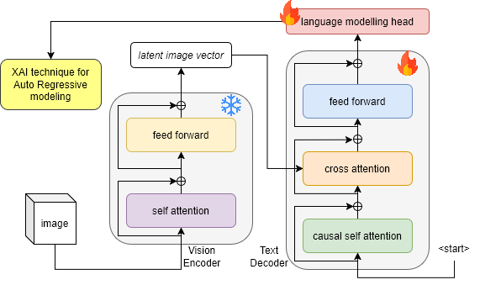
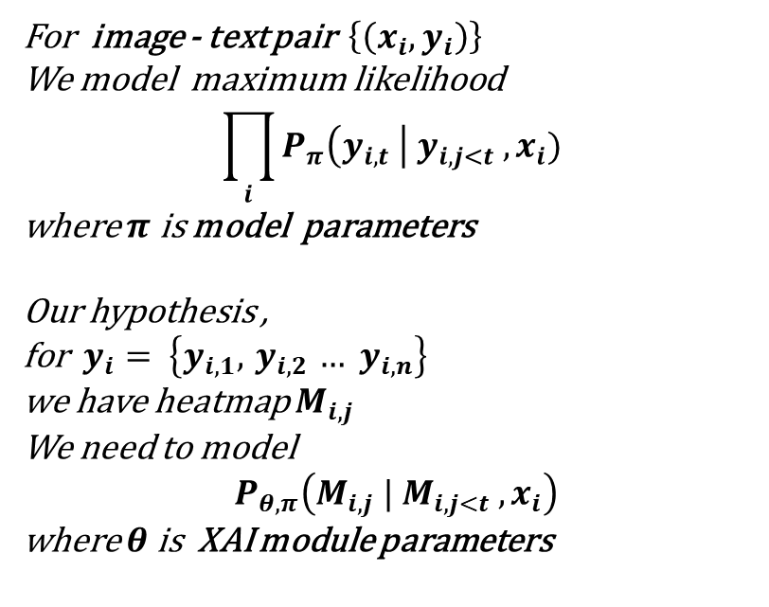
Proposed Architecture
Utilizing Low Rank Adaptation (LoRA) for dense layer fine tuning
For image - text pair $\left\{\left(x_{i},y_{i}\right)\right\}$
We model maximum likelihood
$$\prod_{i}{P_{π}\left(y_{i,t} \right| y_{i, j<t} , x_{i})}$$
where $π$ is model parameters
Our hypothesis ,
for $y_{i}= \left\{y_{i,1},{ y}_{i,2} … y_{i,n}\right\}$
we have heatmap $M_{i,j}$
We need to model
$$P_{θ,π}\left(M_{i,j} | M_{i,j<t} , x_{i}\right)$$
where $θ$ is XAI module parameters

Slide 16
Dataset
Sr no | Name | Number of Images | Task | Classes | Number of Annotations | Modality
1 | ImageNet | ~ 14 Million | Classification | 1000 | 14M image-level labels | RGB
2 | MS COCO | ~ 330 K | Detection, Segmentation, Captioning | 80 | ~2.5M instance + 5 captions per image | RGB + Text
3 | Pascal VOC | ~11 K | Classification, Detection, Segmentation | 20 | ~27K object annotations | RGB
4 | Open Images v6 | ~9M | Detection, Segmentation | 600 | 16M boxes, 2.8M masks, labels | RGB
5 | Visual Genome | ~108K | Scene Graphs, Captioning, QA | 1,600+ | 5.4M region descriptions, relationships | RGB + Text

Slide 17
Dataset
Sr no | Name | Number of Images | Task | Classes | Number of Annotations | Modality
6 | VQA v2 | ~204K | Visual Question Answering | - | 1.1M questions with answers | RGB + Text
7 | GQA | 113K | VQA (Graph-based) | - | 22M reasoning questions | RGB + Text
8 | Flickr30k Entities | ~31K | Captioning, Phrase Grounding | - | 275K phrases linked to boxes | RGB + Text
9 | NoCaps | ~166K | Image Captioning (open vocab) | - | Natural language captions | RGB + Text
10 | TextVQA | ~28K | VQA (Text in Images) | - | 45K questions | RGB + Text (OCR)

Slide 18
Dataset
Sr no | Name | Number of Images | Task | Classes | Number of Annotations | Modality
11 | CLEVR | 100K | VQA (Synthetic) | - | 1M questions | Synthetic + Text
12 | MS-COCO Captions | ~123K | Image Captioning | - | 5 captions/image (~600K total) | RGB + Text
13 | Conceptual Captions | ~3.3M | Large-scale Captioning | - | 3.3M captions | RGB + Text
14 | SBU Captions | ~1M | Image Captioning | - | 1M captions | RGB + Text
15 | IndoFashion | ~80K | Image Captioning & Classification | ~10 | 80K captions | RGB

Slide 19
Dataset
Name | Number of Images | Task | Classes | Number of Annotations | Modality
IndoFashion | ~80K | Image Captioning & Classification | ~10 | 80K captions | RGB

Slide 20
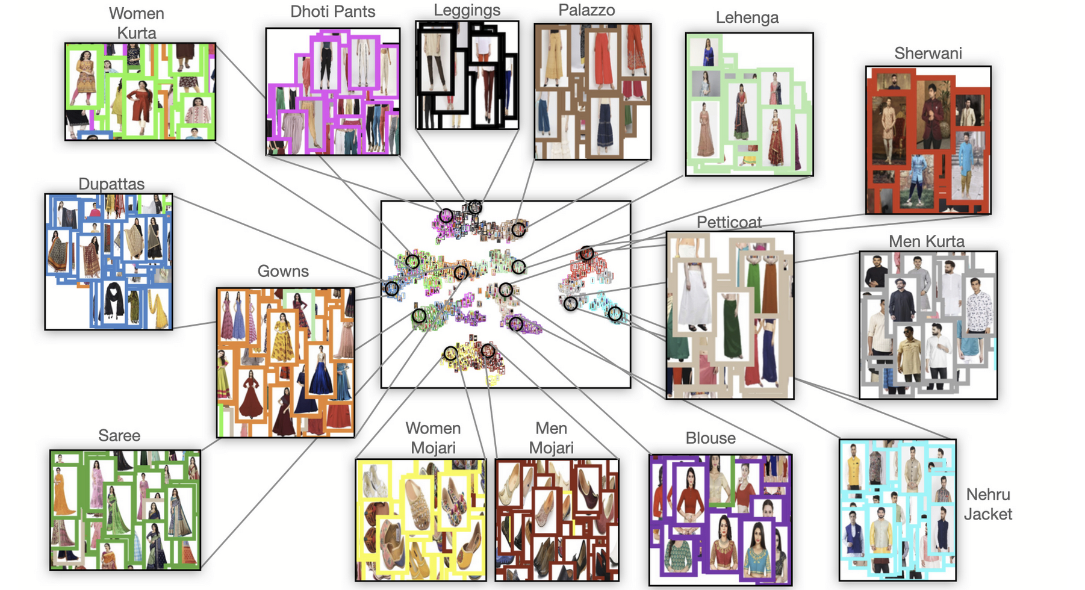
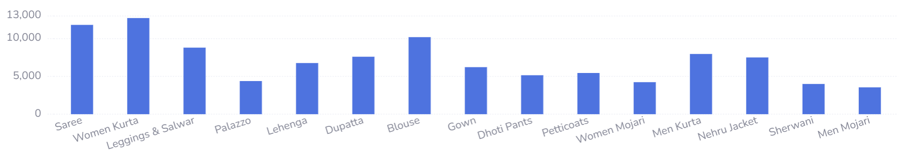
Dataset
IndoFashion
Image captioning & classification
Train – Val – Test (75K, 5K, 5K)
Rajput, P.S. and Aneja, S., 2021. IndoFashion: Apparel classification for Indian ethnic clothes. In Proceedings of the IEEE/CVF conference on computer vision and pattern recognition (pp. 3935-3939).

Slide 21
Dataset
Name | # of img | Task | Classes | # of annotations
IndoFashion | ~80K | Captioning & Classification | 15 | 80K captions
Rajput, P.S. and Aneja, S., 2021. IndoFashion: Apparel classification for Indian ethnic clothes. In Proceedings of the IEEE/CVF conference on computer vision and pattern recognition (pp. 3935-3939).

Slide 22
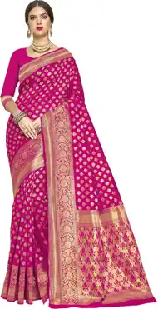

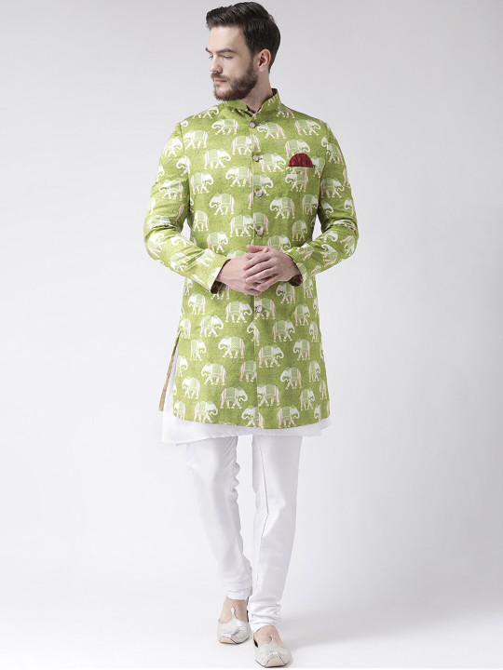
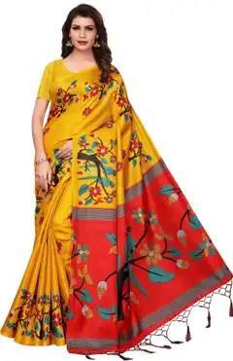
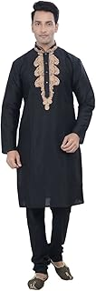
Experiment (Blip Captioning Results)
Greedy decoding
Image | Ground Truth | Generated | BLEU score | chrF score
 | pink sari | a woman in a pink sari sari | 0.0699 | 0.6726
 | white kurta | a man in a white kurt kurt kurt kurt kurt kurt kurt kurt kurt kurt kurt kurt kurt kurt kurt kurt | 0.0091 | 0.3192
 | green and white sherwani | a man in a green and white sher sher sher sher sher sher sher sher sher sher she | 0.0535 | 0.5726
 | yellow sari | yellow polka printed sari sari | 0.0639 | 0.4486
 | black suit | a man in a black suit standing in front of a table | 0.036 | 0.5169

Slide 23
Experiment (Blip Captioning Results)
Top K Decoding : K=10, Temp = 0.5
Image | Ground Truth | Generated | BLEU score | chrF score
 | pink sari | a woman in a pink sari sari | 0.0699 | 0.6726
 | white kurta | a man standing in front of a green wall | 0 | 0.0948
 | green and white sherwani | a man in a green and white sher sher sher she | 0.0933 | 0.7222
 | yellow sari | a woman in a yellow dress standing in front of a floral arch | 0.0155 | 0.2715
 | black suit | a man standing in a room wearing a suit | 0.024 | 0.1482

Slide 24
Experiment (Blip Captioning Results)
Top K Decoding : K=5, Temp = 0.8
Image | Ground Truth | Generated | BLEU score | chrF score
 | pink sari | a model in a pink sari sari | 0.0699 | 0.6726
 | white kurta | a man in a white kurt kurt kurt kurt kurt kurt kurt kurt kurt kurt kurt kurt kurt kurt kurt kurt | 0.0091 | 0.3192
 | green and white sherwani | a man wearing a green and white sher sher sher sher sher sher sher sher sher sher she | 0.0228 | 0.5053
 | yellow sari | a woman in a yellow dress standing in front of a floral arch | 0.0155 | 0.2715
 | black suit | a man in a black suit standing in front of an orange wall | 0.0329 | 0.4718

Slide 25
Experiment (Blip Captioning Results)
Top P Decoding : P=0.5, Temp = 0.5
Image | Ground Truth | Generated | BLEU score | chrF score
 | pink sari | a model in a pink sari sari | 0.0699 | 0.6726
 | white kurta | a man standing in front of a green wall | 0 | 0.0948
 | green and white sherwani | a man in a green and white sher sher sher sher sher sher sher sher sher sher she | 0.0535 | 0.5726
 | yellow sari | a woman in a yellow dress standing in front of a floral arch | 0.0155 | 0.2715
 | black suit | a man standing in a room wearing a black suit | 0.0446 | 0.5429

Slide 26
Experiment (Blip Captioning Results)
Top P Decoding : P=0.8, Temp = 0.8
Image | Ground Truth | Generated | BLEU score | chrF score
 | pink sari | a woman in a pink sari sari | 0.0699 | 0.6726
 | white kurta | a man in a white kurt kurt kurt kurt kurt kurt kurt kurt kurt kurt kurt kurt kurt kurt kurt kurt | 0.0091 | 0.3192
 | green and white sherwani | a man in a green and white sher sher sher sher sher sher sher sher sher sher she | 0.0535 | 0.5726
 | yellow sari | a woman standing in front of a floral backdrop | 0 | 0.0969
 | black suit | a man standing in front of an orange wall | 0 | 0.0604

Slide 27
Future Work
Exploring auto regressive nature for XAI – Design mechanisms to interpret token-by-token generation and visualize patch-to-token attention in ViT-based models
Fashion-Specific Explainability – Incorporate garment attributes and cultural patterns to generate meaningful, human-understandable explanations for Indian fashion imagery.
Evaluation and Integration – Establish quantitative and human evaluation metrics, and integrate the explainability framework into real e-commerce captioning workflows.

Slide 28
References
Selvaraju, R.R., Cogswell, M., Das, A., Vedantam, R., Parikh, D. and Batra, D., 2017. Grad-cam: Visual explanations from deep networks via gradient-based localization. In Proceedings of the IEEE international conference on computer vision (pp. 618-626)
Sundararajan, M., Taly, A. and Yan, Q., 2017, July. Axiomatic attribution for deep networks. In International conference on machine learning (pp. 3319-3328). PMLR.
Covert, I., Kim, C. and Lee, S.I., 2022. Learning to estimate shapley values with vision transformers. arXiv preprint arXiv:2206.05282.
Binder, A., Montavon, G., Lapuschkin, S., Müller, K.R. and Samek, W., 2016. Layer-wise relevance propagation for neural networks with local renormalization layers. In Artificial Neural Networks and Machine Learning–ICANN 2016: 25th International Conference on Artificial Neural Networks, Barcelona, Spain, September 6-9, 2016, Proceedings, Part II 25 (pp. 63-71). Springer International Publishing.
Rußwurm, M. and Körner, M., 2020. Self-attention for raw optical satellite time series classification. ISPRS journal of photogrammetry and remote sensing, 169, pp.421-435
Abnar, S. and Zuidema, W., 2022. Quantifying attention flow in transformers. arXiv 2020. arXiv preprint arXiv:2005.00928, 10.

Slide 29
References
Barkan, O., Hauon, E., Caciularu, A., Katz, O., Malkiel, I., Armstrong, O. and Koenigstein, N., 2021, October. Grad-sam: Explaining transformers via gradient self-attention maps. In Proceedings of the 30th ACM International Conference on Information & Knowledge Management (pp. 2882-2887)
Chefer, H., Gur, S. and Wolf, L., 2021. Transformer interpretability beyond attention visualization. In Proceedings of the IEEE/CVF conference on computer vision and pattern recognition (pp. 782-791).
Nalmpantis, A., Panagiotopoulos, A., Gkountouras, J., Papakostas, K. and Aziz, W., 2023. Vision diffmask: Faithful interpretation of vision transformers with differentiable patch masking. In Proceedings of the IEEE/CVF Conference on Computer Vision and Pattern Recognition (pp. 3756-3763).
Yu, L. and Xiang, W., 2023. X-pruner: explainable pruning for vision transformers. In Proceedings of the IEEE/CVF conference on computer vision and pattern recognition (pp. 24355-24363).
Liang, Y., Ge, C., Tong, Z., Song, Y., Wang, J. and Xie, P., 2022. Not all patches are what you need: Expediting vision transformers via token reorganizations. arXiv preprint arXiv:2202.07800.

Slide 30
References
Pan, B., Panda, R., Jiang, Y., Wang, Z., Feris, R. and Oliva, A., 2021. IA-RED $^ 2$: Interpretability-aware redundancy reduction for vision transformers. Advances in neural information processing systems, 34, pp.24898-24911.
Xie, W., Li, X.H., Cao, C.C. and Zhang, N.L., 2022. Vit-cx: Causal explanation of vision transformers. arXiv preprint arXiv:2211.03064.
Kim, S., Nam, J. and Ko, B.C., 2022, June. Vit-net: Interpretable vision transformers with neural tree decoder. In International conference on machine learning (pp. 11162-11172). PMLR.
Niu, Y., Ding, M., Ge, M., Karlsson, R., Zhang, Y., Carballo, A. and Takeda, K., 2024. R-cut: Enhancing explainability in vision transformers with relationship weighted out and cut. Sensors, 24(9), p.2695.
Yu, L., Xiang, W., Fang, J., Chen, Y.P.P. and Chi, L., 2023. ex-vit: A novel explainable vision transformer for weakly supervised semantic segmentation. Pattern Recognition, 142, p.109666

Slide 31
References
Hafner, M., Katsantoni, M., Köster, T., Marks, J., Mukherjee, J., Staiger, D., Ule, J. and Zavolan, M., 2021. CLIP and complementary methods. Nature Reviews Methods Primers, 1(1), p.20.
Wang, J., Mao, Y., Guan, N. and Xue, C.J., 2024. SHAP-CAT: A interpretable multi-modal framework enhancing WSI classification via virtual staining and shapley-value-based multimodal fusion. arXiv preprint arXiv:2410.01408.
Liu, S., Zeng, Z., Ren, T., Li, F., Zhang, H., Yang, J., Jiang, Q., Li, C., Yang, J., Su, H. and Zhu, J., 2024, September. Grounding dino: Marrying dino with grounded pre-training for open-set object detection. In European Conference on Computer Vision (pp. 38-55). Cham: Springer Nature Switzerland.
Choi, H., Jin, S. and Han, K., 2024. ICEv2: Interpretability, Comprehensiveness, and Explainability in Vision Transformer. International Journal of Computer Vision, pp.1-18.
Yellinek, N., Karlinsky, L. and Giryes, R., 2025. 3VL: Using Trees to Improve Vision-Language Models’ Interpretability. IEEE Transactions on Image Processing.

Slide 32
References
Kirillov, A., Mintun, E., Ravi, N., Mao, H., Rolland, C., Gustafson, L., Xiao, T., Whitehead, S., Berg, A.C., Lo, W.Y. and Dollár, P., 2023. Segment anything. In Proceedings of the IEEE/CVF international conference on computer vision (pp. 4015-4026).
Li, J., Li, D., Xiong, C. and Hoi, S., 2022, June. Blip: Bootstrapping language-image pre-training for unified vision-language understanding and generation. In International conference on machine learning (pp. 12888-12900). PMLR
Beyer, L., Steiner, A., Pinto, A.S., Kolesnikov, A., Wang, X., Salz, D., Neumann, M., Alabdulmohsin, I., Tschannen, M., Bugliarello, E. and Unterthiner, T., 2024. Paligemma: A versatile 3b vlm for transfer. arXiv preprint arXiv:2407.07726.
Beyer, L., Steiner, A., Pinto, A.S., Kolesnikov, A., Wang, X., Salz, D., Neumann, M., Alabdulmohsin, I., Tschannen, M., Bugliarello, E. and Unterthiner, T., 2024. Paligemma: A versatile 3b vlm for transfer. arXiv preprint arXiv:2407.07726.
Yang, A., Li, A., Yang, B., Zhang, B., Hui, B., Zheng, B., Yu, B., Gao, C., Huang, C., Lv, C. and Zheng, C., 2025. Qwen3 technical report. arXiv preprint arXiv:2505.09388

Slide 33
References
Vishal Jayaswal, Rajneesh Rani, Jagdeep Kaur et al. A Comprehensive Survey on Image Captioning for Indian Languages: Techniques, Datasets, and Challenges, 13 November 2023, PREPRINT (Version 1) available at Research Square [https://doi.org/10.21203/rs.3.rs-3601177/v1]
Rajput, P.S. and Aneja, S., 2021. IndoFashion: Apparel classification for Indian ethnic clothes. In Proceedings of the IEEE/CVF conference on computer vision and pattern recognition (pp. 3935-3939).
Banerjee, R.H., Ravi, A. and Dutta, U.K., 2021, May. Attr2style: A transfer learning approach for inferring fashion styles via apparel attributes. In Proceedings of the AAAI Conference on Artificial Intelligence (Vol. 35, No. 17, pp. 15255-15261).
Moratelli, N., Barraco, M., Morelli, D., Cornia, M., Baraldi, L. and Cucchiara, R., 2023. Fashion-oriented image captioning with external knowledge retrieval and fully attentive gates. Sensors, 23(3), p.1286.

Slide 34
References
Islam, S.M., Joardar, S. and Sekh*, A.A., 2024. A survey on fashion image retrieval. ACM Computing Surveys, 56(6), pp.1-25.
Bansal, R., Jain, K., Tyagi, T. & Bansal, R. (2024) Leveraging AI and Computer Vision for Generating Precise E-Commerce Product Descriptions. IOSR Journal of Computer Engineering (IOSR-JCE), 26 (6, Ser. 3), pp. 15–24. DOI: 10.9790/0661-2606031524.
Bai, Y., Garg, U., Shanker, A., Zhang, H., Parajuli, S., Bas, E., Filipovic, I., Chu, A.N., Fomitcheva, E.D., Branson, E. and Kim, A., 2024. Let's Go Shopping (LGS)--Web-Scale Image-Text Dataset for Visual Concept Understanding. arXiv preprint arXiv:2401.04575.

Slide 35
Thanks

Slide 36
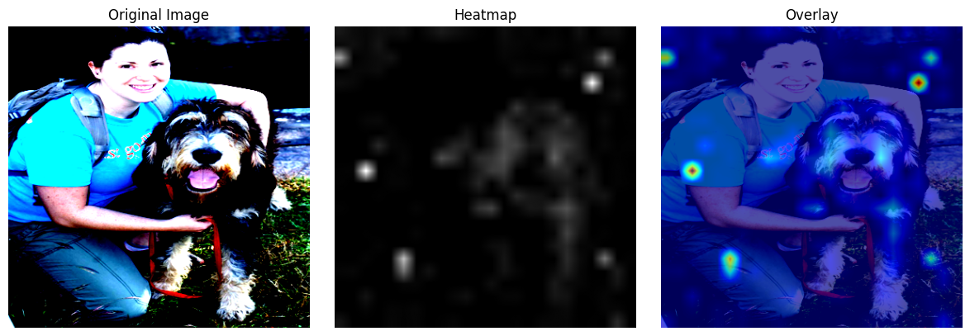
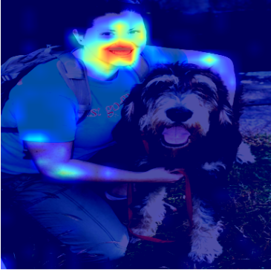
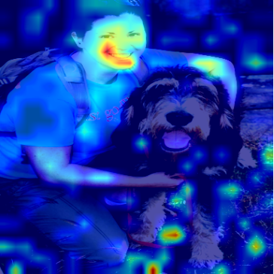
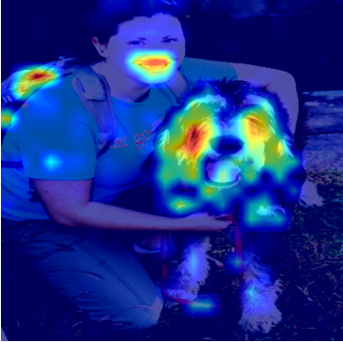
Miscellaneous
Transformed Image
a woman with dog
BLIP image captioning
& Grad Cam (with attention layers)
Auto regressive nature

